Slide 1





The Start-up funding problem
GitHub Link : https://github.com/anilpatel369/startups.git
Prepared by :
Anil Patel – 55
Nishit Gosar – 30
Ayushi Sharma – 23
Yash Jashnani – 31

Slide 2
Disruptive start-ups have been all the rage over the past decade, especially in U.S, which is one of the top countries for launching a new start-up business. (Ernst & Young G20 Entrepreneurship Barometer)
U.S. also leads in funding, thanks to its large network of VC firms, angel investors, and crowd-funding.

Slide 3
BUT 90% of start-ups fail within the first five years of their commencement.
(According to IBM Institute for Business Value and Oxford Economics)

Slide 4
The investment strategies used for investing in these companies are mostly based on intuition or past experience.
And a lot of these start-ups have lost over hundreds of millions of dollars.
Here, investors rely primarily on the background of the founders, size of the market being addressed and the ability of the company to scale after tasting early success.

Slide 5



Our Solution
Use data science to make more scientific and meaningful decisions.
Investors can take a more data-driven approach to filter out the good prospects from the bad ones by using various machine learning algorithms.

Slide 6
Objectives
Visualize the data to find meaningful insights
Using machine-learning models, predict the success or the failure of a new prospective start-up
Identify key factors that drive this success or the failure of these start-up ventures

Slide 7
The dataset
Details of 472 startup companies across various industries
Classification problem with two classes (startup’s success or failure)
Total of 115 feature columns

Slide 8
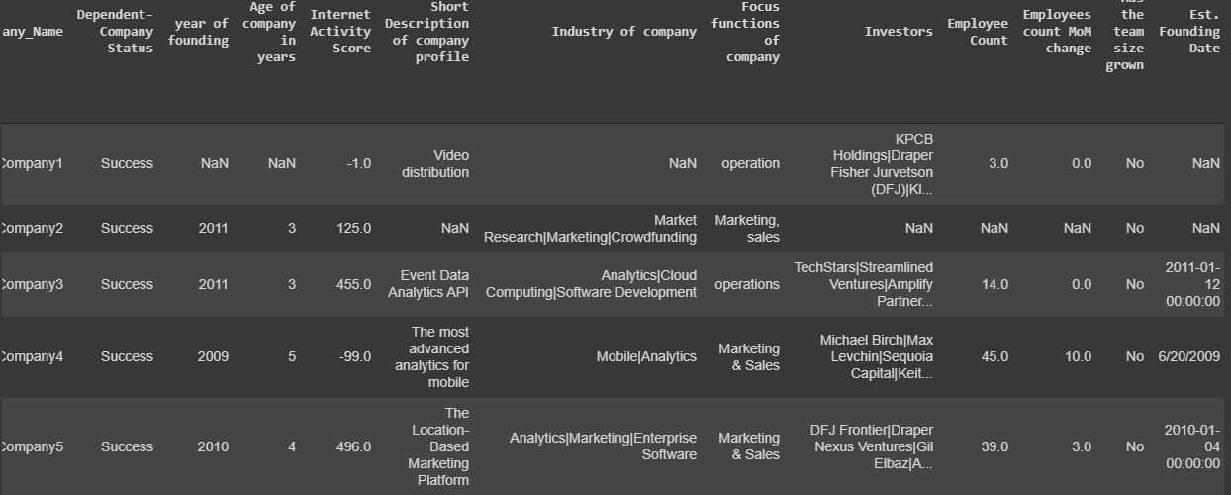
Data Snapshot

Slide 9
Details
Data Category | Column Names
Company founders | Education, Variety of experience etc.
Market potential | Time to market maturity in tech, Competitors, Garter Hype cycle stage, etc.
Geographical details | Country of origin, country of operation, continent, etc.
Operating Industry | Operations, marketing, research, analytics, etc.
Investments-related | last investment made, total times made, amount etc.
Employee-related | Details of employee distribution based on department

Slide 10
Our main data source: CrunchBase, CrowdAnalytix Data compiled from:
Factors | Potential Data Sources | Rationale and Reference
Highest education level of founders | LinkedIn profile of founder, Company website | Higher the education levels are better the success rate
Gartner hype cycle | http://www.gartner.com/technology/research/hype-cycles | If a company is too early or too late in a hype cycle, lesser the success rate
Verticals/Industries the company caters to | Company website, LinkedIn profile of the company | Company should be catering to industries that are growing and have the market potential
Direct Competitors | www.Hoovers.com, www.cbinsights.com | More competitors there are lesser the success rate
Estimated Market potential | IDC Report- www.IDC.com/report | Higher the market potential, better the success rate
Breadth of experience across verticals for founder | LinkedIn profile of Founder, Company website | Verticals the founder has experience with will also affect the success of a startup

Slide 11
Data Pre-processing [472 rows X 116 columns]
Missing values imputation
Changing “No info” to NaN
Finding column-wise missing value percentage
Depending on type of data present in columns, missing values were imputed using EM method and Mode.
Feature Selection
Initial features: 115
Removed repetitive and irrelevant columns manually, features reduced to 91
Selecting top 50 features using ensemble learning methods.
Data preparation
Independent variables reduced to 50
Applying OneHotEncoding to important categorical features, columns increased to 65
Dataset split into training and testing data (80/20)

Slide 12
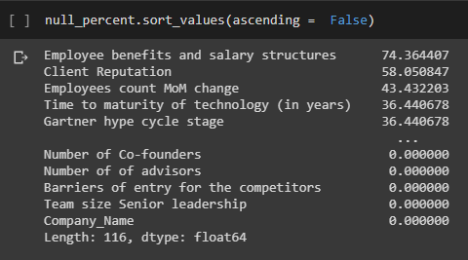
Missing Value imputation
Columns with more than 40% missing values were dropped [3 columns]
Missing values of continuous variables (Ratio & Interval scale data) were imputed by EM Method using SPSS
Missing values of discrete variables (Nominal & Ordinal scale data) were imputed by mode values

Slide 13
Expectation-Maximization method
Using an iterative process, the EM method estimates the means, the covariance matrix, and the correlation of quantitative (scale) variables with missing values.
EM estimation depends on the assumption that the pattern of missing data is related to the observed data only. (This condition is called missing at random, or MAR)
Little’s MCAR test is used to check whether the data is missing completely at random or not.

Slide 14
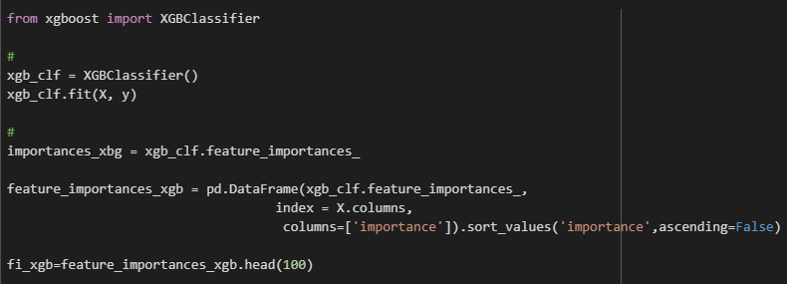
Feature Selection and Data preparation
Random Forest, XGBoost, Gradient Boosting algorithms used to find feature importance
The same was then exported to Excel

Slide 15
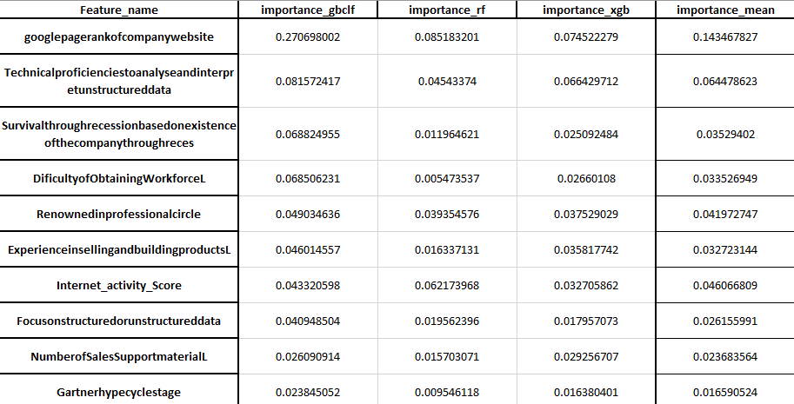
Feature Selection and Data preparation
Then a simple VLOOKUP function and AVG function was used to find out the top 50 features

Slide 16
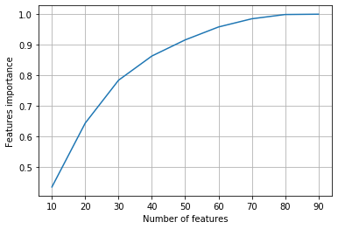
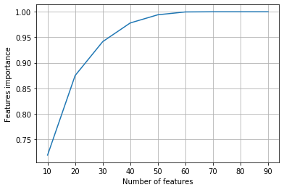
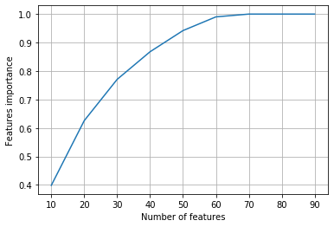
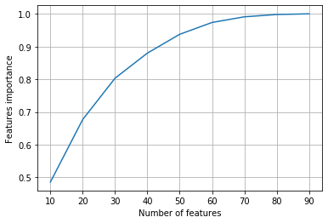
Cumulative feature importance
Sum of Importance
Random
Forest
Gradient
Boost
Extreme Gradient Boost
Mean
N u m b e r o f f e a t u r e s

Slide 17







Exploratory Data Analysis

Slide 18
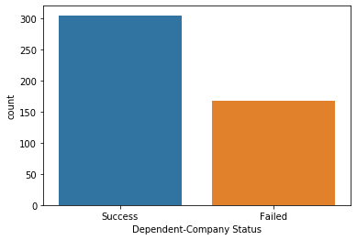
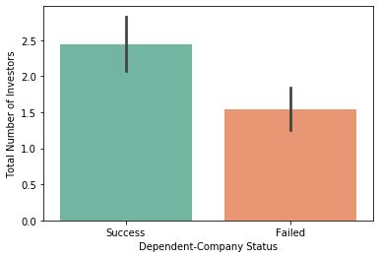
Target class distribution and
Total number of Investors

Slide 19
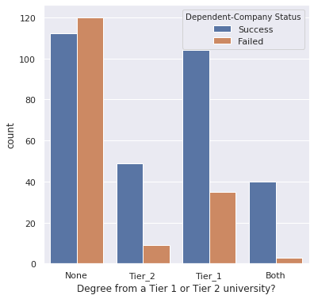
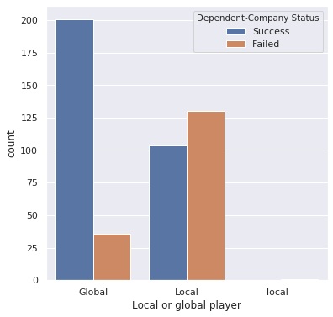
Business focus and
Management’s Highest degree of education

Slide 20
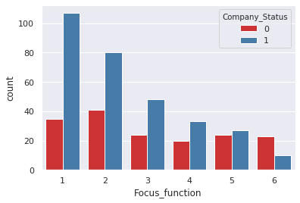
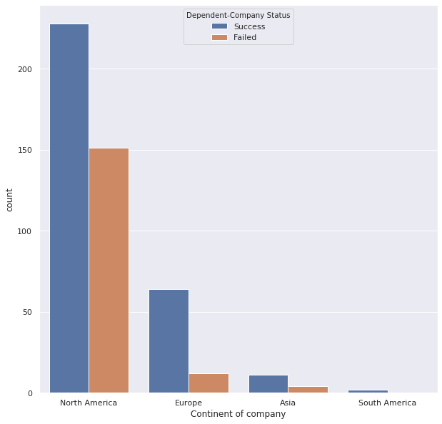
Industry Focus & Location

Slide 21
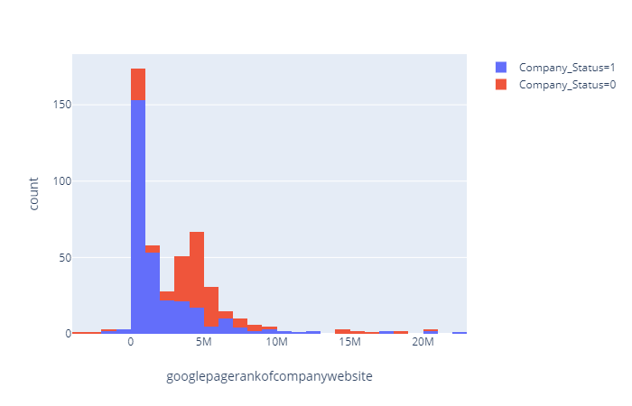
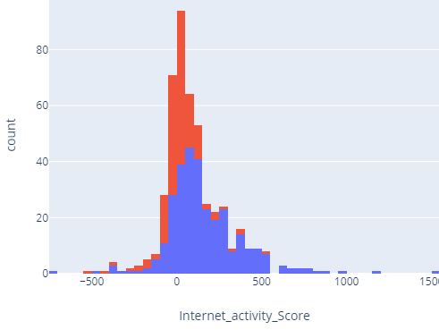
Google Page rank
and
Internet activity score

Slide 22
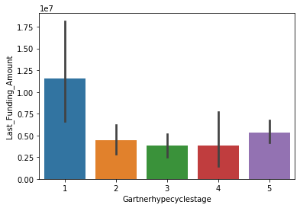
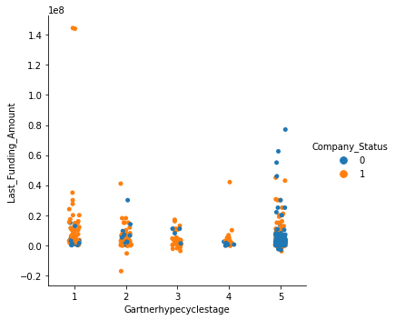
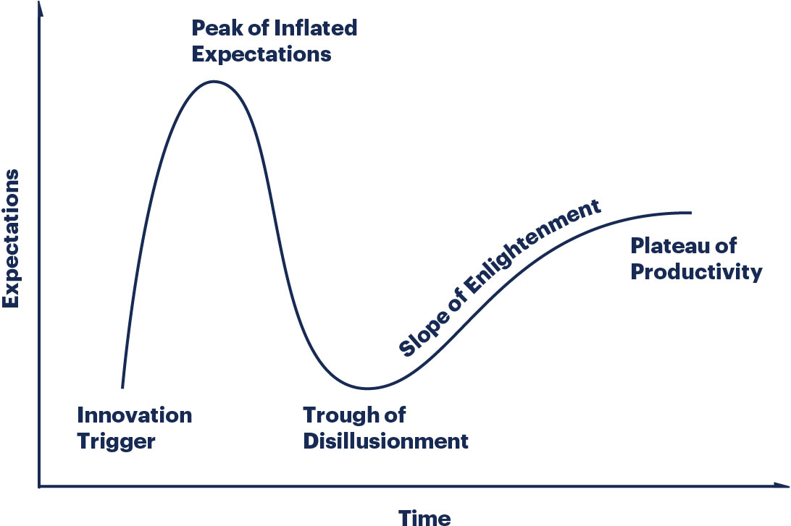
Gartner Hype Cycle
(Trigger, Peak, Trough, Slope, Plateau)
2
5
4
1
3

Slide 23
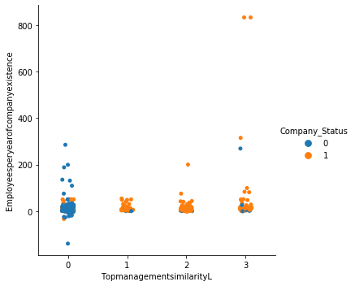
Top management’s similarity

Slide 24
Model Training
After processing and preparing the data, it’s time to train the machine learning models and predict the success or the failure of the start-up companies

Slide 25
Support Vector Machine
SVM is more effective in high dimensional spaces, works relatively well when there is clear margin of separation between classes.
SVM is relatively memory efficient.
Advantages
In cases where number of features for each data point exceeds the number of training data sample , the SVM will under perform
SVM algorithm is not suitable for large data sets.
Disadvantages

Slide 26
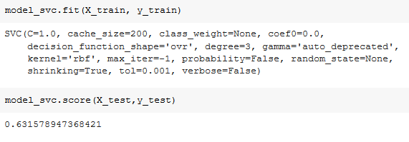
Support Vector Classification
(With train-test split as 80%-20%)

Slide 27
Naive Bayes
Advantages
It is simple and if the conditional independence assumption actually holds, it will converge quicker than discriminative models.
Performs well when we have multiple classes
It requires less model training time
Disadvantages
The Naive Bayes models cannot represent complex behavior
It is not suitable when the correlated data is used
As it treats all the features as unrelated.

Slide 28
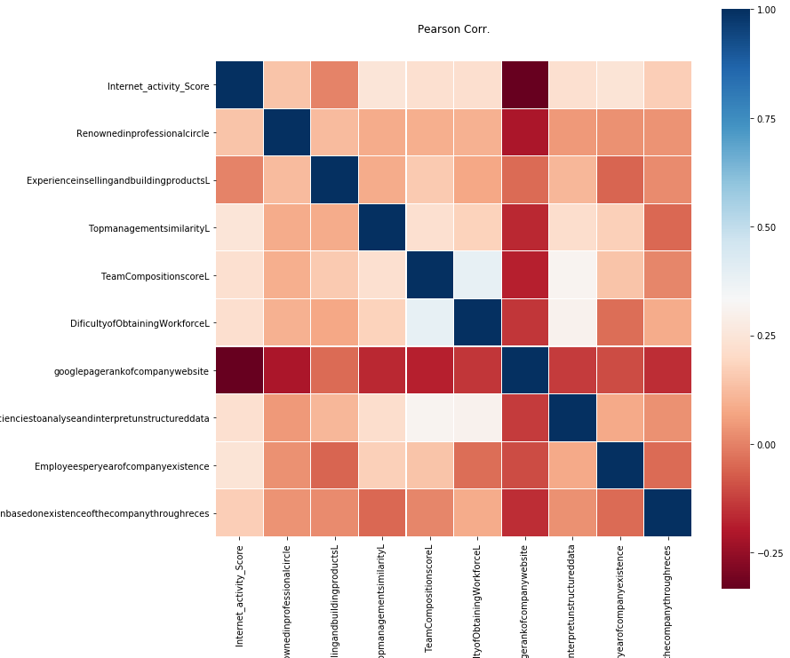
Correlation Matrix for Top 10 features
Features_name
googlepagerankofcompanywebsite
Technicalproficienciestoanalyseandinterpretunstructureddata
Internet_activity_Score
Renownedinprofessionalcircle
Survivalthroughrecessionbasedonexistenceofthecompanythroughreces
TeamCompositionscoreL
DificultyofObtainingWorkforceL
ExperienceinsellingandbuildingproductsL
Employeesperyearofcompanyexistence
TopmanagementsimilarityL

Slide 29
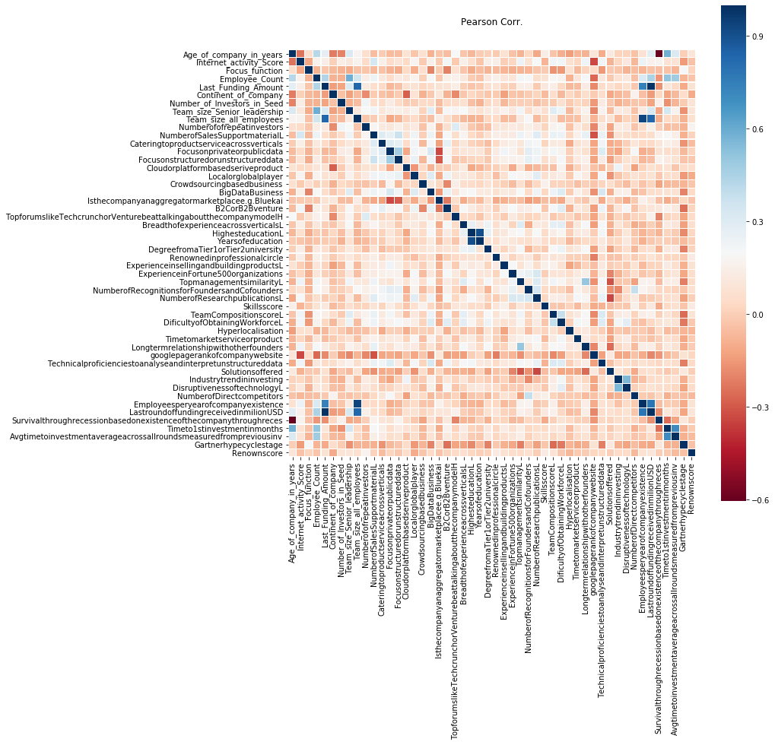
Correlation Matrix for top 50 features

Slide 30

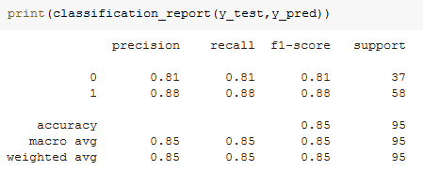
Naive Bayes – GaussianNB (with GridSearchCV)
Classification report with train-test split as 80%-20%
Mean test score with CV=5

Slide 31
K-Nearest Neighbors
Advantages
No training period
Seamless addition of new data
Easy implementation
Disadvantages
Does not work well with high dimensions.
Feature Scaling needed and it does not work well with large dataset
Sensitive to noisy data and missing value data.

Slide 32
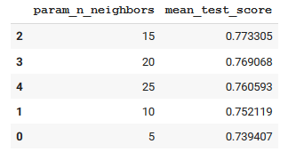
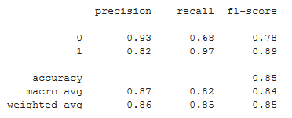
K-Nearest Neighbors with Hyperparameter tuning & GridSearchCV
Hyperparameters considered
(with CV=5) :
- n_neighbours: {5,10,15,20,25}
- algorithm : {auto }
Classification report -

Slide 33
Decision Tree
Advantages
Decision Trees are easy to interpret and visualize.
It can easily capture non-linear pattern as well as requires fewer data preprocessing from the user.
It can be used for feature engineering such treating missing values, suitable variable selection
Disadvantages
Sensitivity to noisy data.
A small variation (or variance) in data can result in different decision tree.
Decision tress are biased with imbalanced dataset

Slide 34
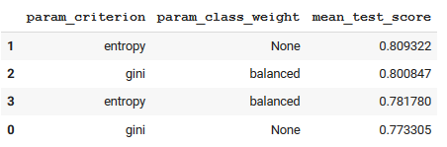
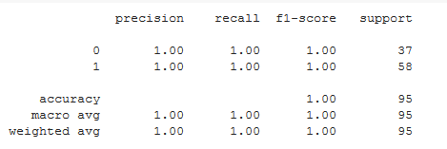
Decision Tree with Hyperparameter tuning & GridSearchCV
Hyperparameters considered
(with CV=5) :
- Criterion : { gini, entropy }
- class_weight : {None, balanced }
Classification report -

Slide 35
Logistic Regression
Advantages
One of the simplest and fastest algorithms to train and implement.
Feature Engineering plays an important role in regards to the performance of Logistic Regression.
Due to its low variance it is less prone to over fit making it very adequate for binary classification problems with a clear separation of classes
Disadvantages
If the number of observations are lesser than the number of features, Logistic Regression may lead to overfitting.
Logistic Regression can be easily outperformed by more complex ones.
we can’t solve non-linear problems with logistic regression since it’s decision surface is linear.

Slide 36
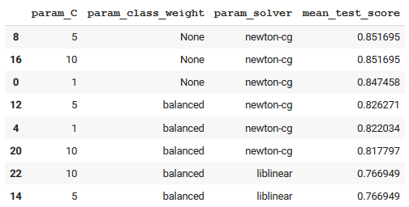
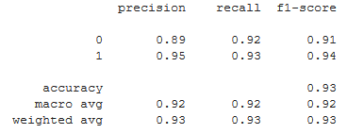
Logistic Regression with Hyperparameter tuning & GridSearchCV
Hyperparameters considered
(with CV=5) :
- C : {1, 5, 10}
- class_weight : {None, balanced}
- solver : {newton-cg, lbfgs, liblinear, saga}
Classification report -
Showing top 8 combinations out of 24 possible combinations

Slide 37
Random Forest
Handles the Bias-variance trade-off and numerous input features without feature deletion and gives estimates of what variables are important to the classification.
Processes missing data and maintains high accuracy when this proportion is large
Advantages
Disadvantages
Random Forest model size is very large and if not carefully built, it results to over fitting
When your data is dynamic and keeps changing, using a RF would to rebuild the forest every time something changes.

Slide 38
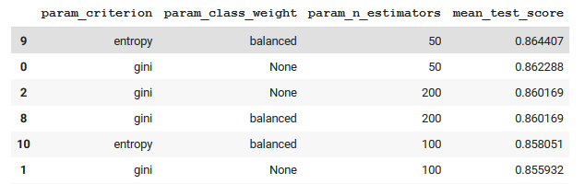
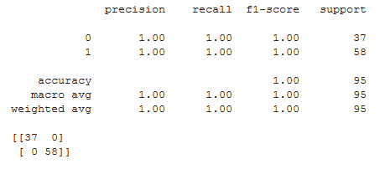
Random Forest Classification with Hyperparameter tuning & GridSearchCV
Hyperparameters considered
(with CV=5) :
- Criterion : { gini, entropy }
- class_weight : {None, balanced }
- n_estimators : { 50,100,200 }
Classification report & confusion matrix

Slide 39
XGBoost Classifiers
Advantages
Higher accuracy than bagging tree-based algorithms
Parallel Processing improves speed and accuracy of the model
Availability of cross validation, regularization
Disadvantages
Danger of model overfitting
Requires higher processing power, expensive
Difficult to interpret

Slide 40
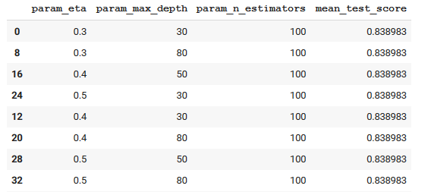

XGboost Classification with Hyperparameter tuning & GridSearchCV
Hyperparameters considered
(with CV=5) :
- Eta : [0.2,0.3,0.4,0.5]
- max_depth : [30,40,50,50,70,80]
- n_estimators : [60,100,200,400,600]
Accuracy on Test data
Showing top 8 combinations out of 32 possible combinations

Slide 41
Feature_Names | Importance
Google Page Ranking | 7.45%
Technical Proficiency with Structured Data | 6.64%
Top management similarity | 4.05%
Renowned score | 3.75%
Experience in selling and building products | 3.58%
Internet activity Score | 3.27%
Number of Sales Support material | 2.93%
Disruptiveness of technology | 2.81%
Highest Degree from Tier1 or Tier2 university | 2.69%
Difficulty of Obtaining Workforce | 2.66%
These are some of the top factors that determine the success or the failure of a startup.
Final Model Used: Random Forest
Accuracy: 86.44%

Slide 42
Thank You

